Slide 1

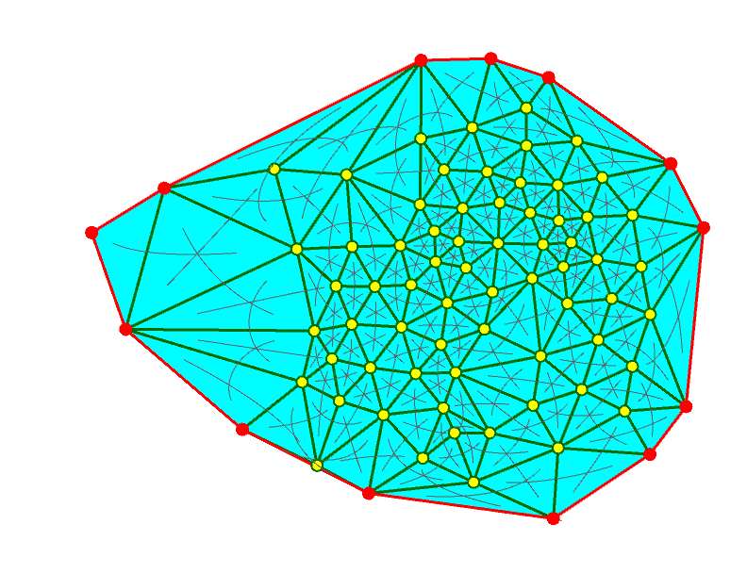
Working with Triangle meshes
CS3451 FALL 2020
Alexander GOEBEL

Slide 2
PHSE 1: Problem statement
The purpose of phase 1 is to distinguish interior and border vertices in a triangle mesh.
COMMENTS:
A vertex can be a member of one or multiple faces (have multiple corners).

Slide 3
PHSE 1: Solution outline
For every corner, I determined whether or not the next corner’s vertex is on the border by using the implementation design that if a corner has no opposite its opposite is marked as itself.
Initially, all vertices are assumed be interior vertices
Every corner is tested for [O(C) == C], and if this is true, the next corner’s vertex is recognized to be a border vertex.
This solution works even though a given vertex might be on the border but have a previous corner that happened to have an opposite, as we only set the vertex to border if the condition is true and never set anything to interior (aside from the initial condition).

Slide 4
PHSE 1: Solution math
c.o = c
JUSTIFICATION:
If c has no opposite, c faces the border and thus c.n (and c.p) are both on the border.

Slide 5
PHSE 1: Solution examples and limitations
Corners with no opposites mean that c.n is on the border. If a corner has an opposite, no assumptions are made as a separate corner with one of the vertices might not have an opposite.

Slide 6
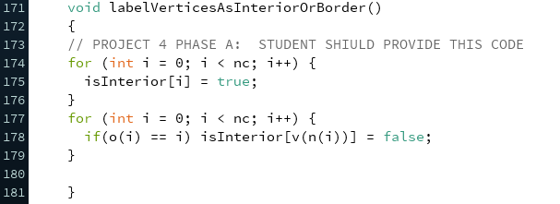
PHSE 1: Code

